Slide 1

🛒 DMART Retail Dataset 🛒
Exploratory Data Analysis (EDA) Case Study

Slide 2
About me
Background :
My name is Naga Srinu kala . I have done my B.sc computer science at G.B.R Degree College affiliated by Adikavi Nannaya University in Rajamundry.
I am learning data science to build a future-ready career by solving real-world problems with data.
LINKEDIN: https://www.linkedin.com/in/nagasrinu-kala-626b73365/
GITHUB: https://github.com/Nagasrinukala

Slide 3
Project Context : -
This data presents an Exploratory Data Analysis (EDA) case study on synthetic DMART retail data. The analysis aims to uncover customer purchase behavior, sales performance, and business insights to support decision-making.

Slide 4
Key Objectives : -
Perform in depth analysis of retail transaction data.
Understanding customer demographic and purchasing patterns.
Analize sales performance across different dimensions.
Extract meaningful business insights from the data .
Dataset Overview : -
The dataset contains 214,000 retail transactions with 15 columns representing various aspects of customer purchases.

Slide 5
DATA UNDERSTANDING
Columns:
Transaction ID - Unique identifier for each transaction.
Store ID - Identifier for the store where purchase was made.
Product Category - Broad category of purchased product.
Sub Category - More specific product classification.
Customer Age - Age of the customer.
Customer Gender - Gender of the customer.
Purchase Amount - Total amount spent in the transaction.
Discount Applied - Discount amount applied.
Payment Mode - Method of payment (e.g., Card).
Rating - Customer rating for the transaction.
Quantity - Number of items purchased.
Loyalty Card - Whether customer has a loyalty card.
Region - Geographic region of the store.
Weekday - Day of week when purchase occurred.
Store Type - Type of store (e.g., Express, Hypermarket).

Slide 6
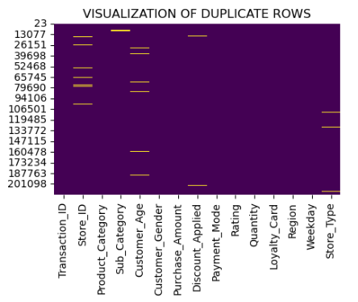
DATA CLEANING & Manipulation
Handle Duplicates in Dataset : -
Checking Duplicates in all columns .
Shape of Dataset is 214000 rows and 15 columns.
Non Duplicate columns are 208667 and Duplicate Columns are 5333 .
After removing Duplicates :-
Using drop.duplicates() to remove the duplicates from dataset.
Shape of Dataset is 208667 rows and 15 columns.
Non Duplicate columns are 208667 and Duplicate Columns are 0 .

Slide 7
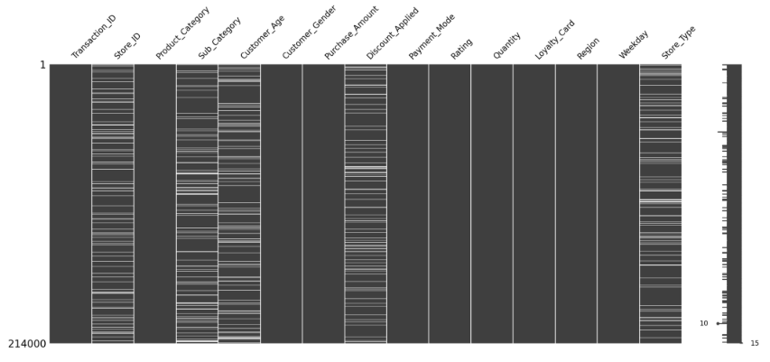
Handle Null values in Dataset : -
After removing duplicates of the dataset , there is 5 columns have null values
Numerical Columns & Discrete numerical Columns
Customer Age
Discount Applied
Categorical Columns
Store ID
Sub Category
Store Type

Slide 8
Filling Numerical Null values in Dataset : -
Filling Null Numerical columns with Mean .
I fill the all missing values in all Numerical columns with their respective mean values using pandas .
Basic Method ( using fillna ( ) with mean ( ) ).
Filling Categorical Null values in Dataset : -
Filling Null Categorical columns with Mode .
I fill the all missing values in all Categorical columns with their respective mode values using pandas
Basic Method ( using fillna ( ) with mode ( ) .

Slide 9
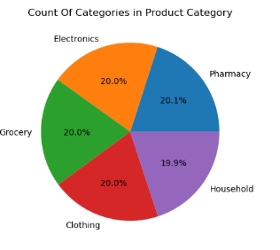
DATA VISUALIZATION
Univariate Analysis: Examining individual variables
Product Category – Categorical Column
Visualize this column using pie chart to understand How many categories are present .
Pharmacy - 20.1%
Electronics - 20.0%
Grocery - 20.0%
Clothing - 20.0%
Household - 19.9 %
Grocery , Clothing and Electronics are most frequent.

Slide 10

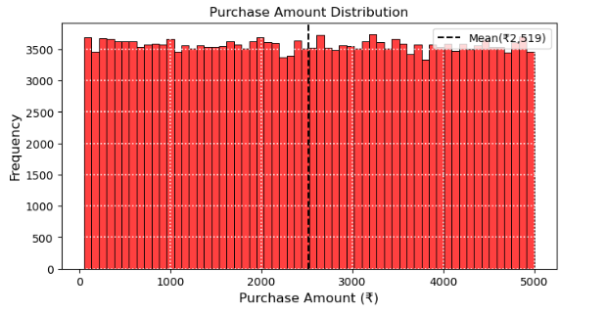
Purchase Amount - Numerical Data
Visualize this column using histogram to understand the average payment by customers.
The mean purchase amount is ₹2,519 .
The purchase amount range from ₹ 0 to ₹ 5000

Slide 11

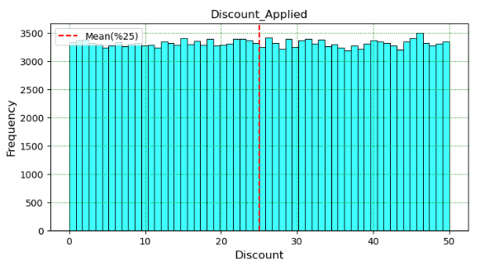

Discount Applied - Numerical Data
Visualize this column using histogram to understand the average Discount .
The average discount applied is 25 % .
The purchase discount range from 0% to 50% .

Slide 12
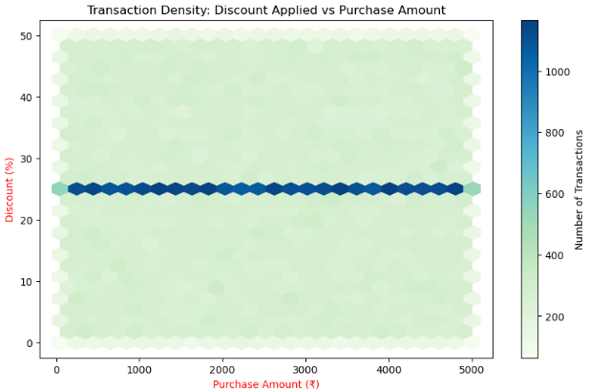
Bivariate Analysis: Examining two variables
Discount Applied vs Purchase Amount – Numerical columns
A horizontal band at around 25% discount suggests that most transactions , regardless of purchase value , receive ~ 25% discount.
High Transaction Density Around ₹2500
The darkest region is centred around:
₹ 2500 - ₹ 3000 in purchase amount
25% discount
Indicates most common transactions are in this range.

Slide 13
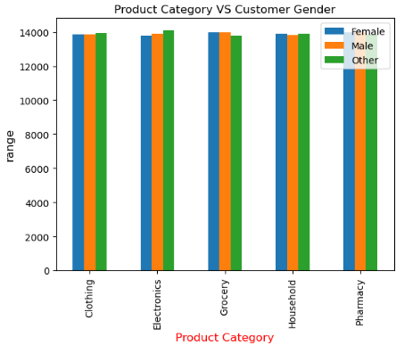
Product Category VS Customer Category – Categorical column
For every product category , purchases by Female , Male and Other genders are very close in numbers.
This suggest a uniform distribution of product interest across genders.
Top Product Categories by Gender
All genders seem to have a slight preference for :
Electronics
Grocery
These categories show marginally higher bars than others.
This could indicate higher demand or utility in these areas.

Slide 14
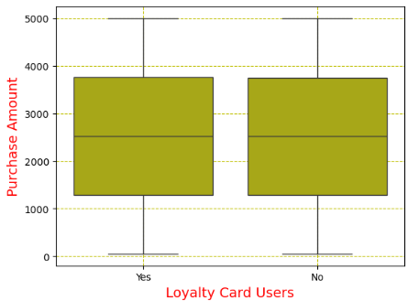
Loyalty Card VS Purchase Amount - Cat Vs Num
Spending Patterns Are Very Similar
Both loyalty card holders and non-holders exhibit almost identical purchasing behaviours, with:
Similar medians
similar ranges
No impactful Outliers
Loyalty Card ≠ Higher Spend(Yet)
Having a loyalty card does not appear to significantly increase
purchase amount per transaction.
Suggests that either the benefits are not strong enough, or loyalty incentives may
influence Long - term retention, not per- transaction value.

Slide 15
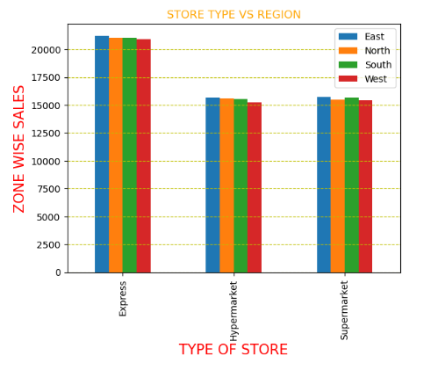
Store Type VS Region - CAT VS CAT
Regional Preference in Store Types : -
Express stores dominate in zone-wise sales across all four regions (East, North, South, West).
The East and North regions have the highest sales in Express stores, indicating a strong preference for this store type.
Hypermarkets and Supermarkets show lower and nearly similar sales across all regions.
The West region consistently records slightly lower sales across all store types.
Overall, there is a clear regional preference for Express stores, likely due to convenience and accessibility.

Slide 17

THANK YOU

